Slide 1
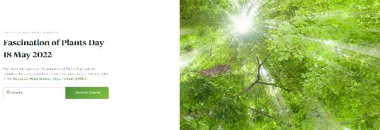
EPSO fosters science with society approaches
Fascination of Plants Day (FoPD) 2022
Already 785 events in 54 countries uploaded
Get inspired by the FoPD 2019 success stories
Contact your national FoPD coordinator to upload it to the FoPD website https://plantday18may.org/
Send success stories to epso@epsomail.org
Hold interactive inspiring events with the public on FoPD 2022 around 18 May 2022 – still possible in summer / autumn 2022
Notes:
Normally describing the fire escapes and where the toilets are.
This time:

